Slide 1

Oracle SQL
SQL SELECT Statements

Slide 2
Objectives
Identify keywords, mandatory clauses, and optional clauses in a SELECT statement
Select and view all columns of a table
Select and view one column of a table
Display multiple columns of a table
Use a WHERE clause to restrict the rows returned by a query
Create a search condition using mathematical comparison operators
Use the BETWEEN…AND comparison operator to identify records within a range of values
Specify a list of values for a search condition using the IN comparison operator
Oracle 11g: SQL

Slide 3
Objectives (continued)
Use a column alias to clarify the contents of a particular column
Perform basic arithmetic operations in the SELECT clause
Remove duplicate lists using either the DISTINCT or UNIQUE keyword
Use concatenation to combine fields, literals, and other data
Search for patterns using the LIKE comparison operator
Identify the purpose of the % and _ wildcard characters
Join multiple search conditions using the appropriate logical operator
Perform searches for NULL values
Specify the order for the presentation of query results using an ORDER BY clause
Oracle 11g: SQL

Slide 4
Create the JustLee Database
Use the provided script to create the database so you can follow the chapter examples
Verify table contents using the DESCRIBE command
Oracle 11g: SQL

Slide 5
SELECT Statement Syntax
SELECT statements are used to retrieve data from the database
A SELECT statement is referred to as a query
Syntax gives the basic structure, or rules, for a command
Optional clauses and keywords are shown in brackets
Oracle 11g: SQL

Slide 6
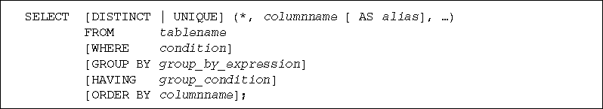
SELECT Statement Syntax (continued)
Oracle 11g: SQL

Slide 7
SELECT Statement Syntax (continued)
SELECT and FROM clauses are required
SELECT clause identifies column(s)
FROM clause identifies table(s)
Each clause begins with a keyword
Oracle 11g: SQL

Slide 8
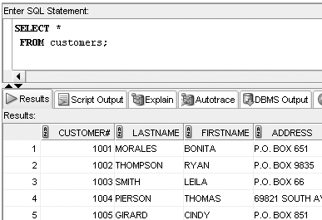
Selecting All Data in a Table
Substitute an asterisk for the column names in a SELECT clause
Oracle 11g: SQL

Slide 9
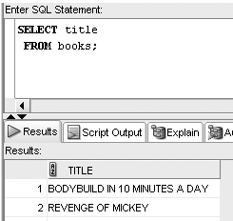
Selecting One Column from a Table
Enter column name in SELECT clause
Oracle 11g: SQL

Slide 10
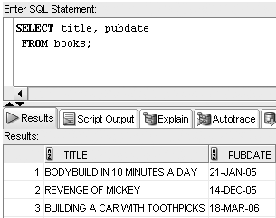
Selecting Multiple Columns from a Table
Separate column names with a comma
Oracle 11g: SQL

Slide 11
Operations within the SELECT Statement
Column alias can be used for column headings
Perform arithmetic operations
Suppress duplicates
Concatenate data
Oracle 11g: SQL

Slide 12
Using Column Aliases
List the alias after the column heading
AS keyword is optional
Enclose in double quotation marks:
  If it contains blank space(s)
  If it contains special symbol(s)
  To retain case
Oracle 11g: SQL

Slide 13
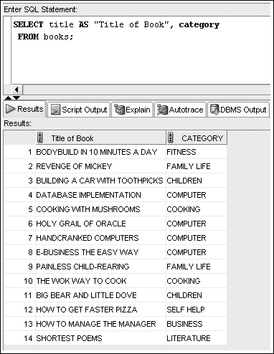
Column Alias Example
Oracle 11g: SQL

Slide 14
Using Arithmetic Operations
Arithmetic operations
  Executed left to right
  Multiplication and division are solved first
  Addition and subtraction are solved last
  Override order with parentheses
Oracle 11g: SQL

Slide 15
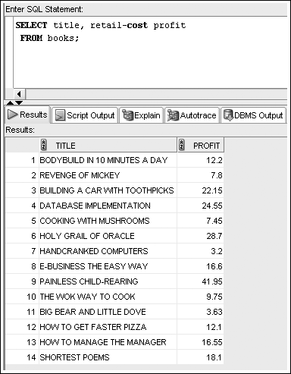
Example Arithmetic Operation with Column Alias
Oracle 11g: SQL

Slide 16
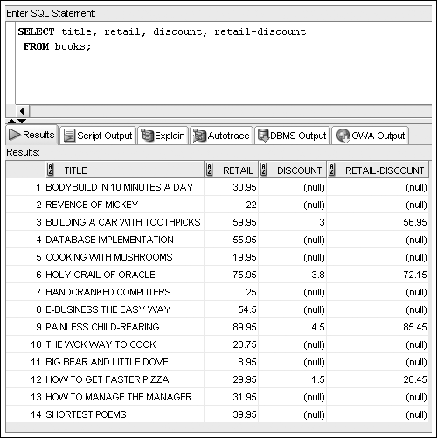
NULL Values
Oracle 11g: SQL

Slide 17
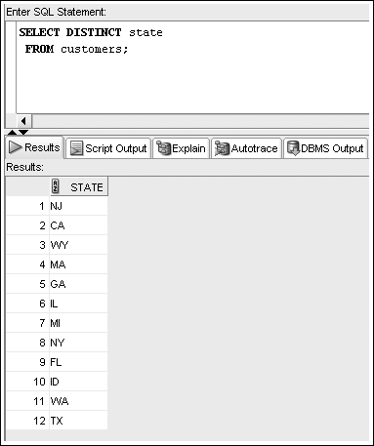
Using DISTINCT and UNIQUE
Enter DISTINCT or UNIQUE after SELECT keyword to suppress duplicates
Oracle 11g: SQL

Slide 18
Using Concatenation
You can combine data with a string literal
Use the concatenation operator, ||
It allows the use of column aliases
Oracle 11g: SQL

Slide 19
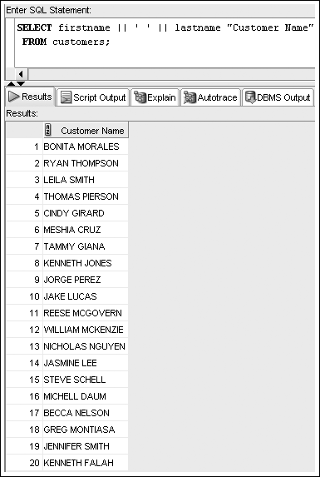
Concatenation Example
Oracle 11g: SQL

Slide 20
WHERE Clause Syntax
A WHERE clause is used to retrieve rows based on a stated condition
Requires:
  Column name
  Comparison operator
  Value or column for comparison
Values are case sensitive
Oracle 11g: SQL

Slide 21
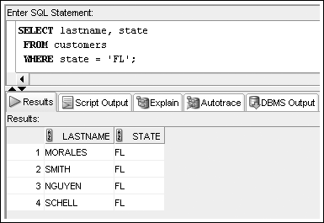
WHERE Clause Example
List WHERE clause after FROM clause
Enclose nonnumeric data in single quotes
Oracle 11g: SQL

Slide 22
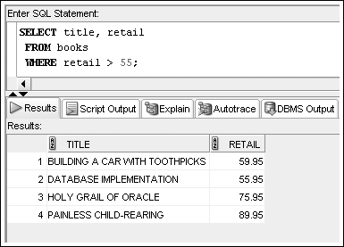
Comparison Operators
Indicate how the data should relate to the given search value
Oracle 11g: SQL

Slide 23
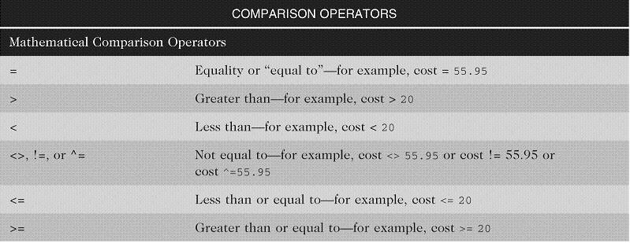
Arithmetic Comparison Operators
Oracle 11g: SQL

Slide 24
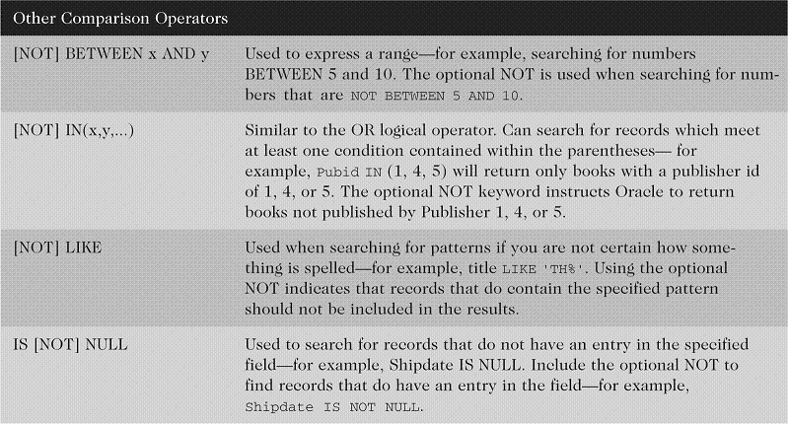
Other Comparison Operators
Oracle 11g: SQL

Slide 25
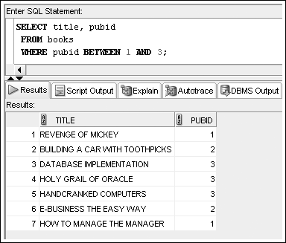
BETWEEN…AND Operator
Finds values in a specified range
Oracle 11g: SQL

Slide 26
IN Operator
Returns records that match a value in a specified list
List must be in parentheses
Values are separated by commas
Oracle 11g: SQL

Slide 27
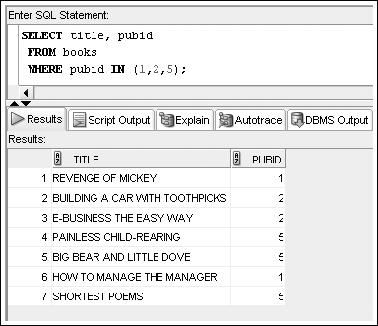
IN Operator Example
Oracle 11g: SQL

Slide 28
LIKE Operator
Performs pattern searches
Used with wildcard characters
  Underscore (_) for exactly one character in the indicated position
  Percent sign (%) represents any number of characters
Oracle 11g: SQL

Slide 29
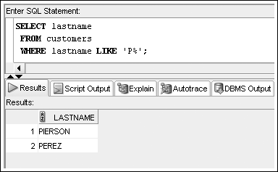
LIKE Operator Example
Oracle 11g: SQL

Slide 30
Logical Operators
Used to combine conditions
Evaluated in order of NOT, AND, OR
  NOT – reverses meaning
  AND – both conditions must be TRUE
  OR – at least one condition must be TRUE
Oracle 11g: SQL

Slide 31
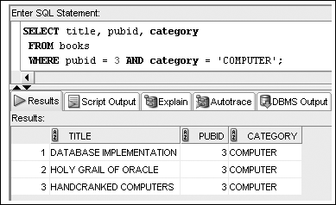
AND Logical Operator Example
Oracle 11g: SQL

Slide 32
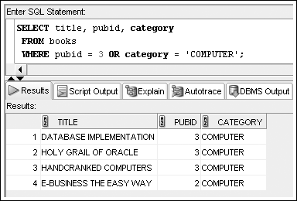
OR Logical Operator Example
Oracle 11g: SQL

Slide 33
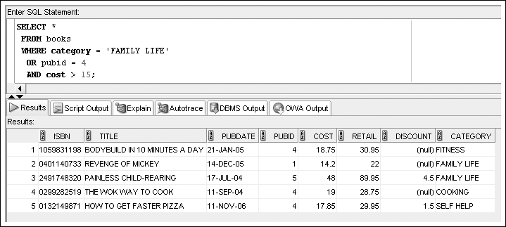
Multiple Logical Operators
Resolved in order of NOT, AND, OR
Oracle 11g: SQL

Slide 34
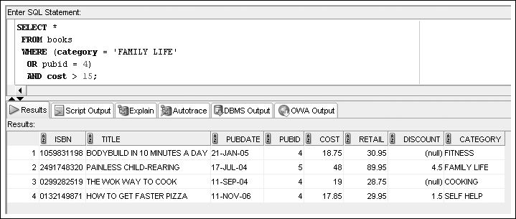
Multiple Logical Operators
Use parentheses to override the order of evaluation
Oracle 11g: SQL

Slide 35
Resolving Multiple Types of Operators
Arithmetic operators
Comparison operators
Logical operators
Oracle 11g: SQL

Slide 36
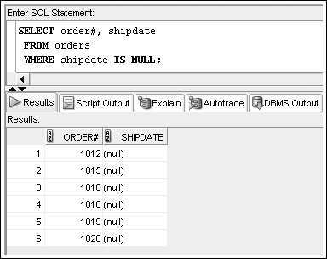
Treatment of NULL Values
Absence of data
Requires use of IS NULL operator
Oracle 11g: SQL

Slide 37
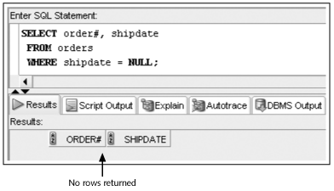
Treatment of NULL Values (continued)
A common error is using = NULL, which does not raise an Oracle error but also does not return any rows
Oracle 11g: SQL

Slide 38
ORDER BY Clause Syntax
The ORDER BY clause presents data in sorted order
Ascending order is default
Use DESC keyword to override column default
255 columns maximum
Oracle 11g: SQL

Slide 39
ORDER BY Clause Syntax
Sort Sequence
In ascending order, values will be listed in the following sequence:
  Numeric values
  Character values
  NULL values
In descending order, sequence is reversed
Oracle 11g: SQL

Slide 40
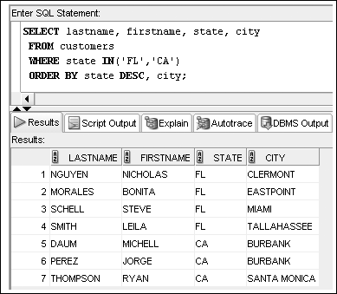
ORDER BY Example
Oracle 11g: SQL

Slide 41
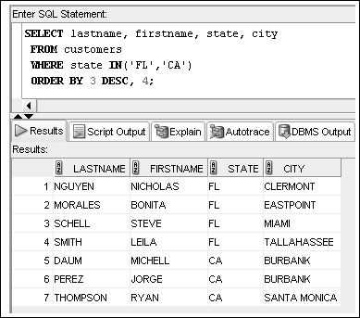
ORDER BY Can Reference
Column Position
Oracle 11g: SQL

Slide 42
Summary
A basic query in Oracle 11g SQL includes the SELECT and FROM clauses, the only mandatory clauses in a SELECT statement
To view all columns in the table, specify an asterisk (*) or list all of the column names individually in the SELECT clause
To display a specific column or set of columns, list the column names in the SELECT clause (in the order in which you want them to appear)
When listing column names in the SELECT clause, a comma must separate column names
Oracle 11g: SQL

Slide 43
Summary (continued)
A column alias can be used to clarify the contents of a particular column; if the alias contains spaces or special symbols, or if you want to display the column with any lowercase letters, you must enclose the column alias in double quotation marks (" ")
Indicate the table name following the FROM keyword
Basic arithmetic operations can be performed in the SELECT clause
NULL values indicate an absence of a value
Oracle 11g: SQL

Slide 44
Summary (continued)
To remove duplicate listings, include either the DISTINCT or UNIQUE keyword
To specify which table contains the desired columns, you must list the name of the table after the keyword FROM
Use vertical bars (||) to combine, or concatenate, fields, literals, and other data
Oracle 11g: SQL

Slide 45
Summary (continued)
The WHERE clause can be included in a SELECT statement to restrict the rows returned by a query to only those meeting a specified condition
When searching a nonnumeric field, the search values must be enclosed in single quotation marks
Comparison operators are used to indicate how the record should relate to the search value
The BETWEEN...AND comparison operator is used to search for records that fall within a certain range of values
Oracle 11g: SQL

Slide 46
Summary (continued)
The LIKE comparison operator is used with the percent and underscore symbols (% and _) to establish search patterns
Logical operators such as AND and OR can be used to combine several search conditions
When using the AND operator, all conditions must be TRUE for a record to be returned in the results
  However, with the OR operator, only one condition must be TRUE
A NULL value is the absence of data, not a field with a blank space entered
Oracle 11g: SQL

Slide 47
Summary (continued)
Use the IS NULL comparison operator to match NULL values; the IS NOT NULL comparison operator finds records that do not contain NULL values in the indicated column
You can sort the results of queries by using an ORDER BY clause; when used, the ORDER BY clause should be listed last in the SELECT statement
By default, records are sorted in ascending order; entering DESC directly after the column name sorts the records in descending order
A column does not have to be listed in the SELECT clause to serve as a basis for sorting
Oracle 11g: SQL

